Slide 1
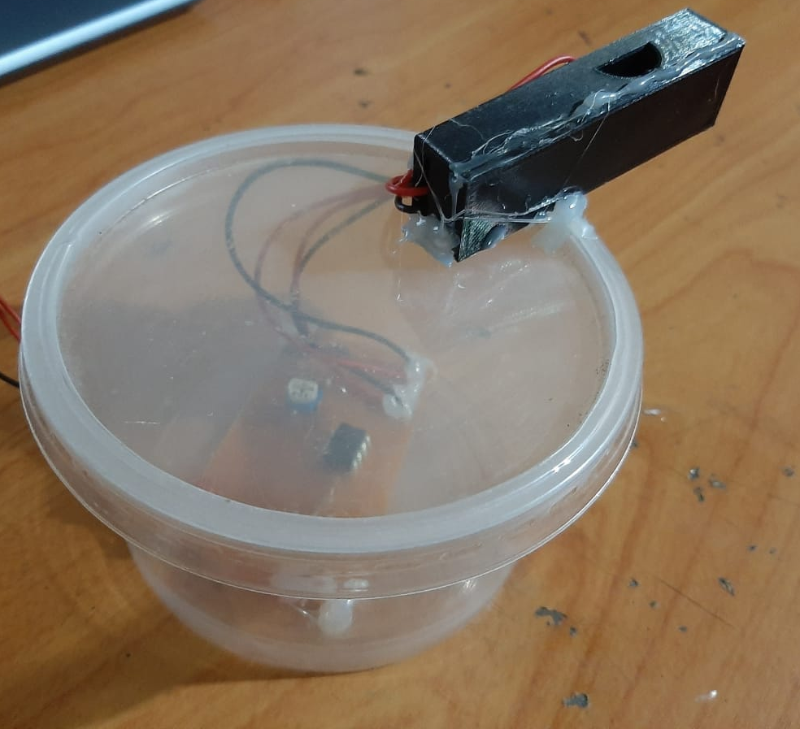
DUST SENSOR
E/19/377 SIRIWARDENA S.J.
E/19/367 SERASINGHE K.T.M.L.S.
E/19/233 MAHANAMA M.G.S.U
GROUP NO. 03

Slide 2

INTRODUCTION
Air pollution is a major threat we face as a world.
Dust is a major fact that causes the air pollution.
Keeping the dust concentration at an environmentally safe level can cause a significant effect to the air pollution.
Dust sensor is intended to measure the concentration of the dust.

Slide 3
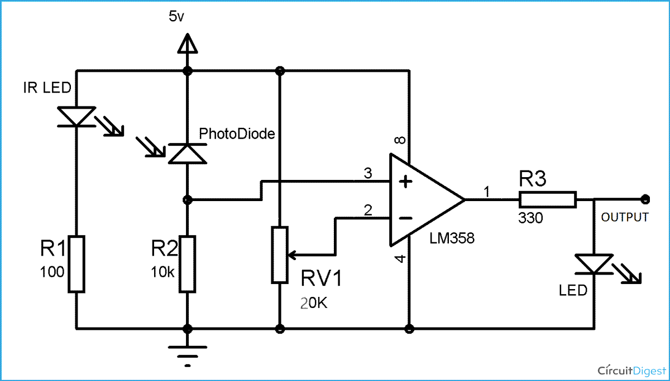
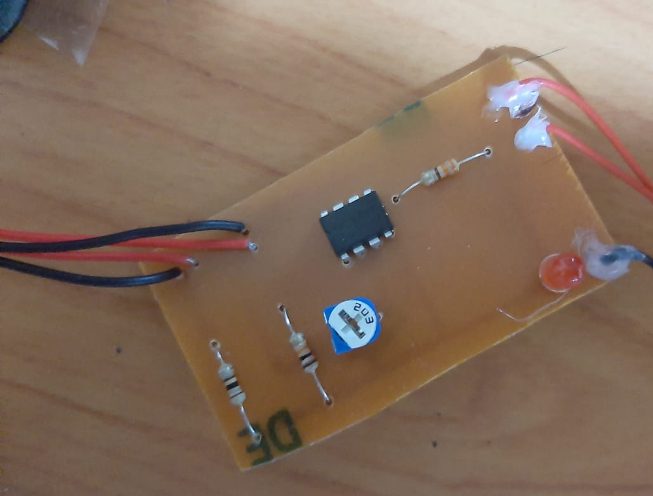
SCHEMATICS
Resistors
Potentiometer
OP-AMP
IR bulb
IR sensor
Arduino UNO board
Wires
LED bulb

Slide 4
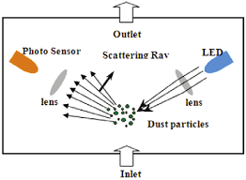
WORKING PRINCIPLE
The sensor module is connected to the 5V DC power supply, IR LED starts emitting infra-red rays.
When those rays reach the dust, the scattered light by the dust is collected by the photodiode. Reverse current of the photodiode flows which is proportional to the illuminance. Therefore, it increase the reverse current with light
It is further amplified by the op-amp.
The output voltage is corelated with the scattered light, thus the dust density in the test space.

Slide 5
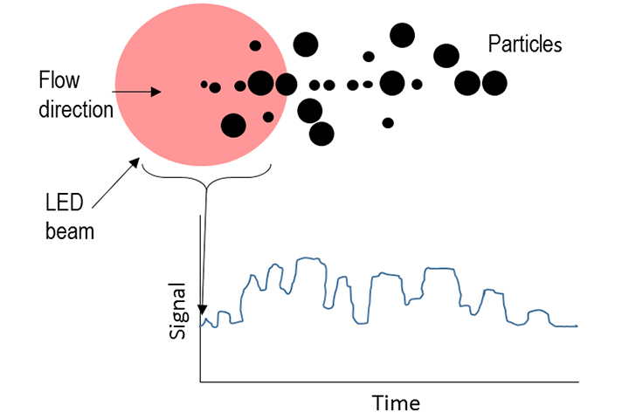
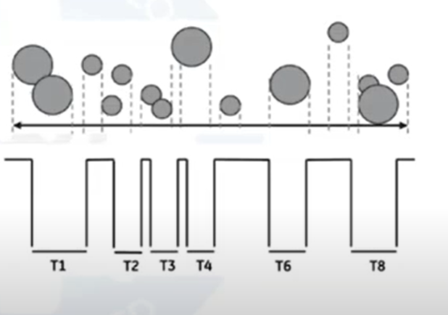
Figure 02
Figure 01

Slide 6
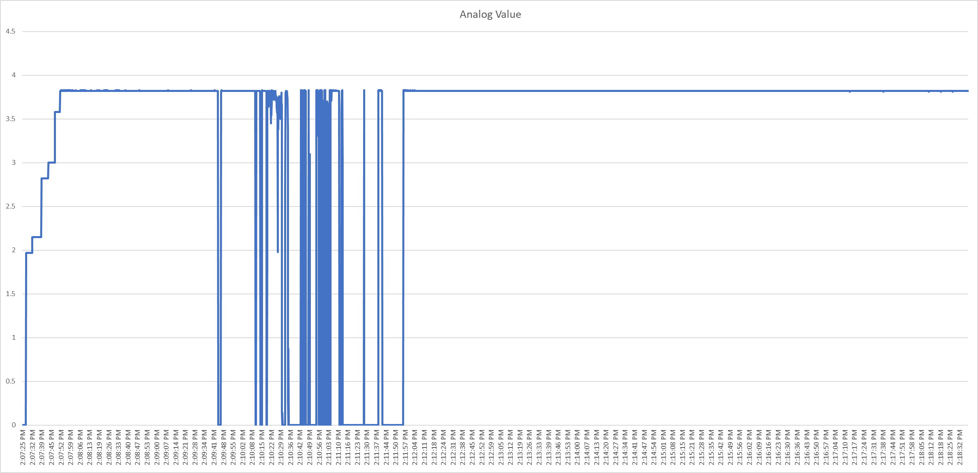

Slide 7
CALIBRATION
Done using a standard particle sensor.
At first, different kinds of dust should be selected.
Each kinds of dust are applied to both sensors at the same time
Output from the dust sensor is corelated with the dust density.
Relationship between the output and the dust density is taken

Slide 8
V
V
t
t
Low Concentration
High Concentration
V
V
t
t
Small Particles
Large Particles

Slide 9
THANK YOU

